Slide 1
What type of Sales Promotion is it?

Slide 2
What are the 5 types of Promotion?
Personal Selling
Advertising
Sales Promotion
Direct Mailing
Public Relations

Slide 3
What is the Purpose of a Sales Promotion
To increase sales

Slide 4
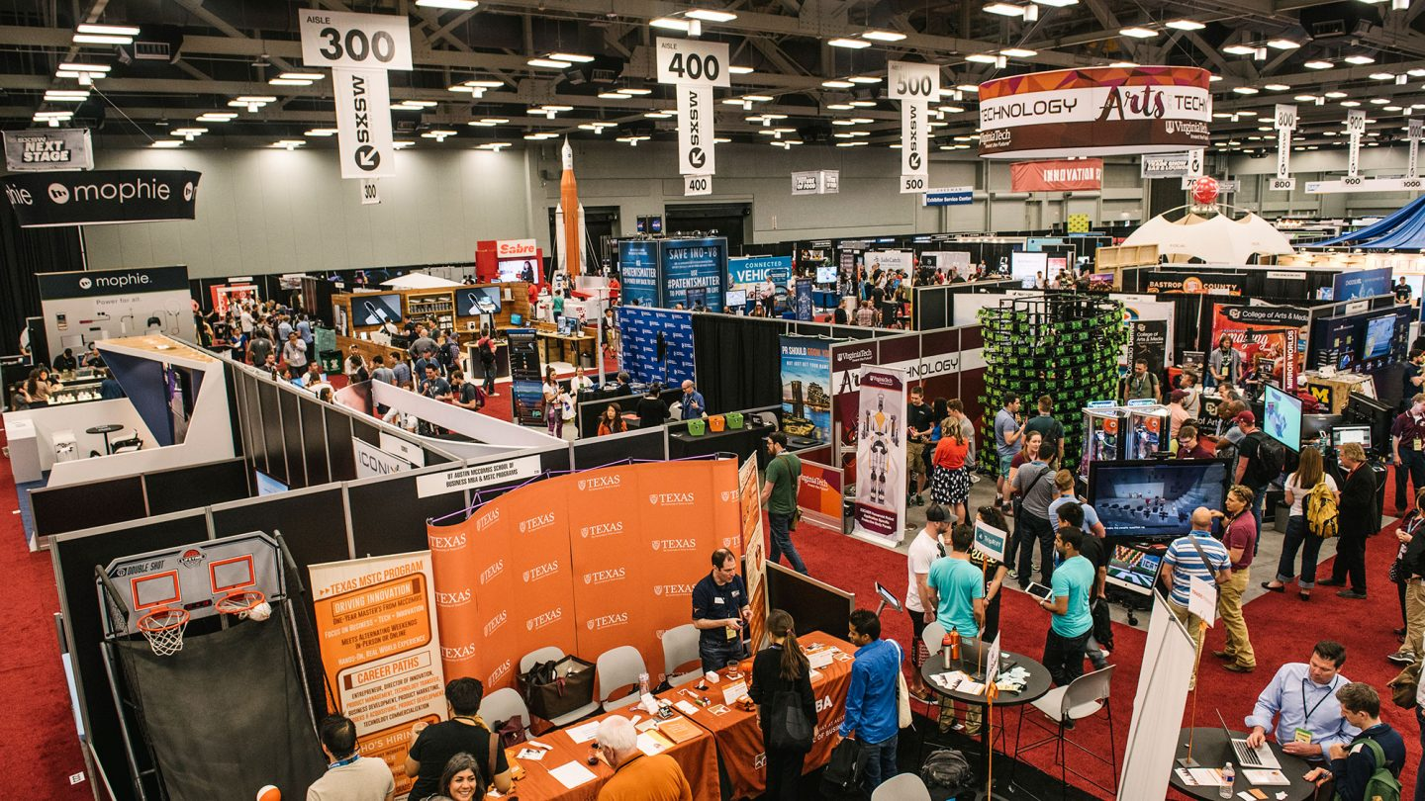
What type of Sales Promotion is it?
Trade Show

Slide 5
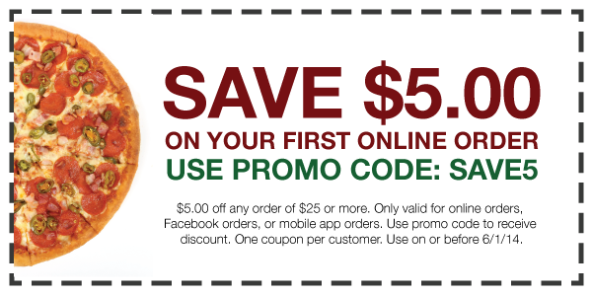
What type of Sales Promotion is it?
Online Discount Code

Slide 6
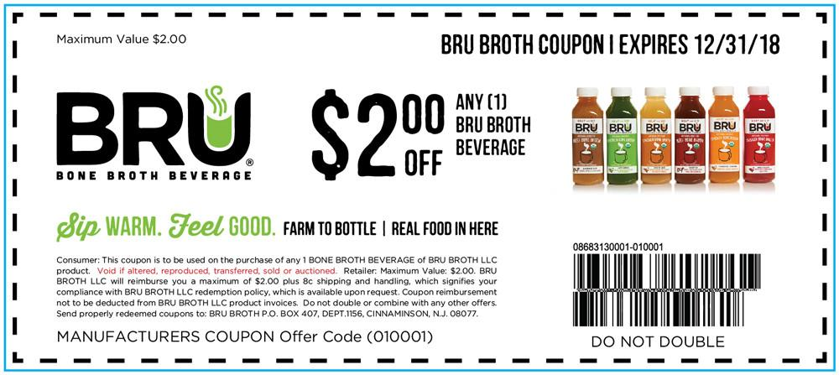
What type of Sales Promotion is it?
Coupon – Has a Bar Code must present to get sale

Slide 7
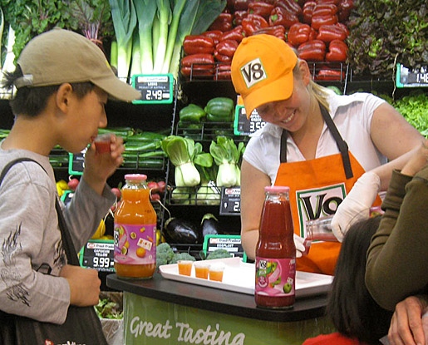
What type of Sales Promotion is it?
Product Samples

Slide 8
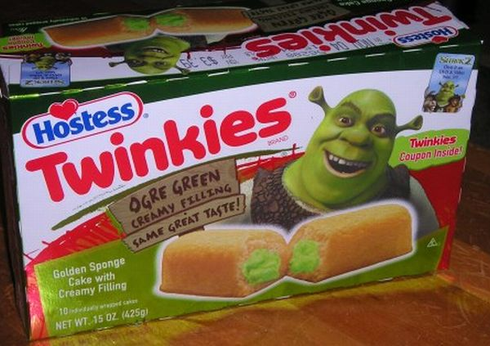
What type of Sales Promotion is it?
Promotional Tie-in – Two products that share the cost of promotion

Slide 9
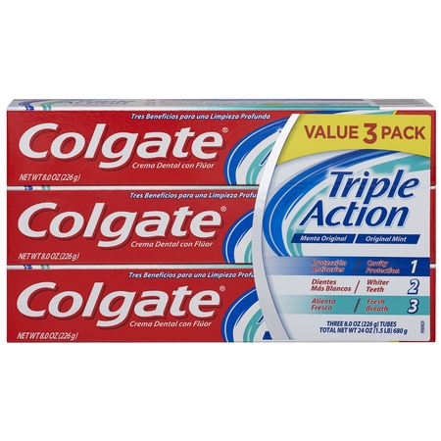
What type of Sales Promotion is it?
Deal – Buy 1 box $3, buy pack of three $6.50

Slide 10

What type of Sales Promotion is it?
Incentive – win high cost items

Slide 11
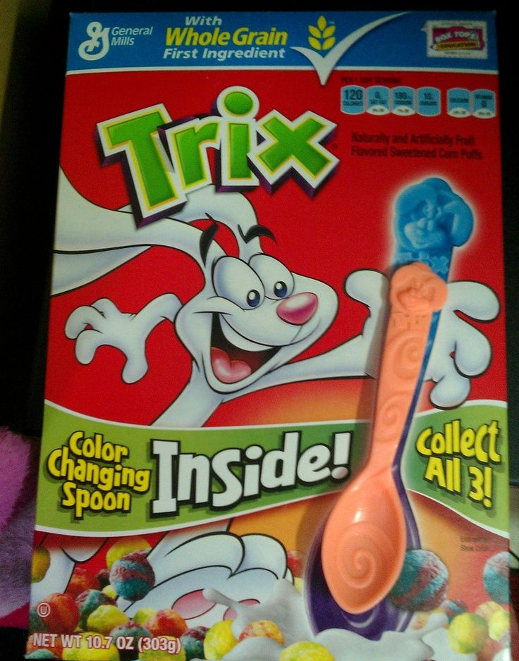
What type of Sales Promotion is it?
Premium –LOW COST item for free

Slide 12
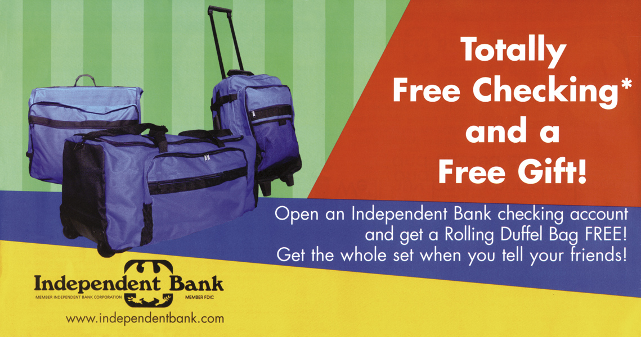
What type of Sales Promotion is it?
Premium

Slide 13
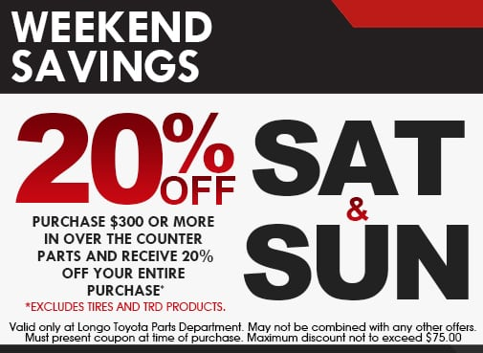
What type of Sales Promotion is it?
Discount– Anyone gets when they shop

Slide 14
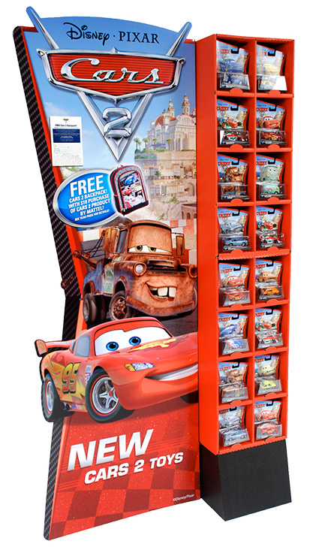
What type of Sales Promotion is it?
Point of Purchase Display

Slide 15
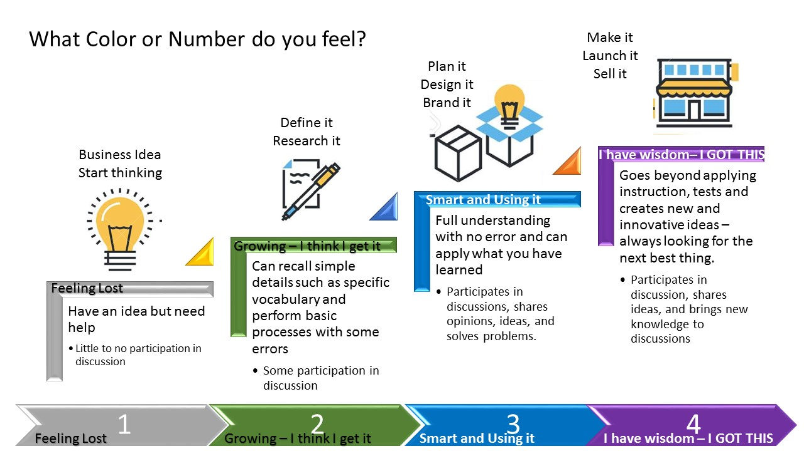

Slide 16
Complete Assignments 17-1 Questions on Classmarker.com

